Slide 1
Networking the Cloud: Remote Replication of VMs over the WAN
K. K. Ramakrishnan
CS 208, Class 7
Paper: Tim Wood et.al.,
“CloudNet: dynamic pooling of cloud resources by live WAN migration of virtual machines”, VEE’11 (https://dl.acm.org/doi/abs/10.1145/2007477.1952699)
Also, IEEE/ACM Transactions on Networking Oct. 2015
(Please read: http://none.cs.umass.edu/papers/pdf/TON15-cloudnet.pdf)

Slide 2
Public, Private, Hybrid Clouds
Not all enterprises are comfortable with using public cloud services
Don’t want to share CPU cycles or disks with competitors
Privacy and regulatory concerns
Private Cloud
Use cloud computing concepts in a private data center
Automate VM management and deployment
Provides same convenience as public cloud
May have higher cost
Hybrid Model
Move resources between private and public depending on load

Slide 3
Deployment Models
Hybrid Cloud
Public Clouds
Private Cloud
Hybrid cloud:
Typically rely on company’s own resources, flex to public cloud resources at peak loads
Cost efficient
Can be made seamless (e.g., the same programming APIs in both clouds)

Slide 4


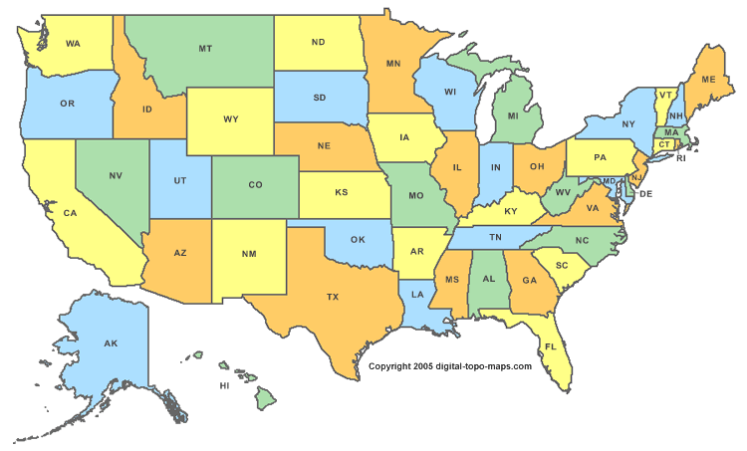


Cloud Isolation
Cloud data centers are isolated from one another and the enterprise
Complicates
Deployment
Security
Resource management
Need a way to flexibly manage IT resources across data centers
Enterprise View

Slide 5
Motivation
Issue: Cloud platforms often not optimized for enterprise use.
Example: Think about Payroll Processing
Acme LAN
Front End & Reports
Processing Tier
Data Store
Processing Tier
Cloud Platform
Notes:
Existing cloud systems not enterprise ready:
No control over network management (no choice of IP addr, no integration with own VPN)
No control of Network Resources (bandwidth, traffic isolation, etc)
Lack of network security and isolation
CloudNet: Enterprise-Ready Virtual Private Clouds
Use VPNs to separate customer resources
Customer’s cloud resources are only reachable from other VPN end points
More flexible control of how IP addresses are assigned
Physical network is transparent to customer

Slide 6
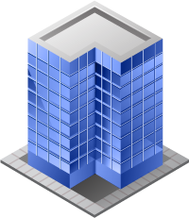


Problem #1: Transparency
Application may have been written for LAN environment
Might utilize broadcast or LAN service discovery
Must add Internet gateways for apps previously only on LAN
- Must now communicate via public IPs and/or configure DNS
Lack of transparency causes application modifications and infrastructure reconfigurations
Acme LAN
Front End
Cloud Platform
GW
front.acme.com
Processing proc.cloud.com
Data Store
GW
data.acme.com

Slide 7




Problem #2: Security
Enterprise’s servers are now accessible from the public Internet!
Servers formerly on secure LAN now exposed to malicious users
Must configure firewall rules to limit access
Fine grained rules are difficult to manage in dynamic environments
Lack of secure cloud connections exposes enterprise to threats from both in and out of the cloud
Acme LAN
Front End
front.acme.com
Cloud Platform
Processing proc.cloud.com
Data Store
data.acme.com
Hacker123 hax.cloud.com

Slide 8
Problem #3: Flexible Resource Mgmt
Benefit of cloud computing: ability to easily adjust resource capacities and add new VMs
After a change must deal with transparency and security issues all over again!
Current platforms do not support network resource reservation (Bandwidth/QoS guarantees)
Enterprises want control over network resources. Cloud must support dynamic changes
Acme LAN
Front End
front.acme.com
+1
Cloud Platform
Processing proc.cloud.com
+1
Data Store
data.acme.com
+1
Processing #2 proc2.cloud.com

Slide 9

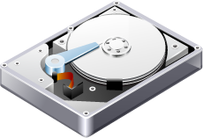
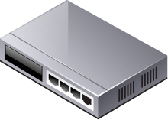

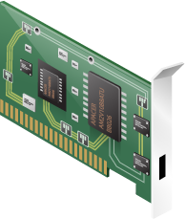

Key Observation
Existing cloud platforms primarily cover computation and storage
Cloud Platform
Disk
+
VM
+
Enterprise Sites
Enterprise Clouds need control over the network as well

Slide 10




Vision: Virtual Cloud Pools
Flexible cross data center resource pools
A secure collection of server, storage, and network resources
Seamlessly connected across cloud and enterprise data centers
Supports dynamic application placement across sites
Enterprise
Sites
Cloud
Sites
Notes:
ADD MIGRATION ANIMATION

Slide 11
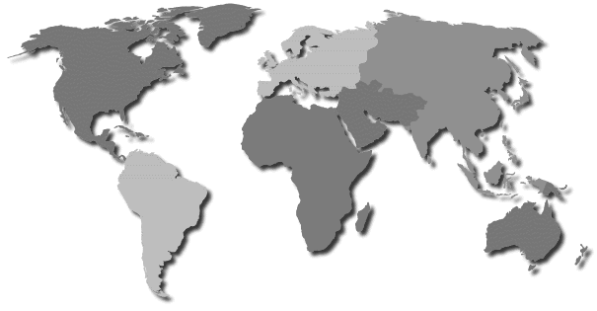
Cloud Pool Use Cases
Enterprise Consolidation
Simplify deployment into the cloud
Minimize downtime and reconfiguration
Cloud Bursting
Many applications cannot be easily replicated
WAN Migration enables dynamic placement
Minimize performance impact
Follow the Sun
Application moves to be closer to clients or data
Minimize planning time and migration bandwidth cost
Notes:
SHORTEN talk, mention network stuff and migration

Slide 12
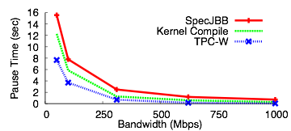
Dynamic Cloud Pools
Goals:
Seamlessly and securely connect enterprise and cloud data centers
Enable efficient migration of resources between data centers
Challenges
Networking: security, transparency, flexibility
WAN Migration: Efficiency, application performance impact
Downtime (sec)

Slide 13
Virtual Private Clouds
A Virtual Private Cloud is…
A secure collection of server, storage, and network resources spanning one or more cloud data centers
That is seamlessly connected to one or more enterprise sites
Virtual Private Networks (VPNs)
Layer 3 and Layer 2 MPLS based VPNs
Created by network provider with no end host configuration
Already used by many businesses!
VM
VM
Cloud
Sites
Enterprise
Sites
VM
VM

Slide 14
VPC Benefits
Virtual Private Clouds: Collection of cloud resources presented to customer as a private set of cloud resources, transparently and securely connected to customer VPN.
For the customer:
Isolates network & compute resources
Cloud resources are only accessible through VPN
Simplifies deployment since the Cloud looks the same as local resources
For the cloud service provider:
Provides mechanism for control over resource reservation within provider network
Simplifies management of multiple data centers by combining them into large resource pools

Slide 15
Seamless Data Center Connections
CloudNet: Use Virtual Private Networks (VPNs)
Creates secure end-to-end network paths
Simpler configuration than firewalls
Managed by network provider with no end host configuration
Layer 2 Virtual Private LAN Service (VPLS)
Bridges the local networks at multiple sites
Used to make cloud resources look as if they are directly attached to enterprise LAN
Allows existing VM migration techniques to work over the WAN!
15

Slide 16
CloudNet
Cloud Manager
Allocates computation and storage resources
Manages VLAN assignment within cloud network
Network Manager
Creates and configures VPN endpoints
Reserves network resources
Routers
Customer Edge
Provider Edge
Network Manager
Cloud Manager
VPN
VLAN
VM
VM
VPN
VLAN
VM
VM
Notes:
Here I explain the basic components of cloudnet and give some more details about what support you would need to add to a system like amazon ec2 to make this work (interface with ISP to control VPN setup at PE routers / connection to VLANs within cloud site)

Slide 17
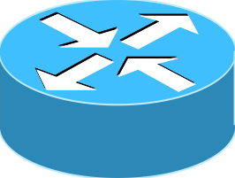

Dynamic VPN Endpoints
Manipulating VPN endpoints can be slow
Manual process, can take days... must reduce this to seconds
CloudNet automates VPN endpoint reconfiguration
Centralized VPN Controller
Acts as route reflector between sites
Can adjust ruleset to modify VPN topology
Route updates propagated via BGP
VPN Controller
+
+
+
Notes:
why is this hard or different?

Slide 18

CloudNet System Components
CloudNet Controller
Portal
VPN A
VPN B
Cloud Platform
Network
Manager
Cloud
Manager
PE
Server
AT&T Backbone
Server
PE
Server
CE
Router
VPN A
Server
PE
VPN B
Server
Cloud Domain
Network Domain
High level abstraction:
Create compute resources
Map into VPN
Cross domain interaction
Cloud Manager:
Create compute resources
Map into VPN (cloud side)
Network Manager (RR-IRSCP):
VPN management (network side)
Dynamic VPN mapping/stitching

Slide 19
CloudNet System Components-Network Domain
Network Manager
VPN A
VPN B
Remapping
RTs
RR
PE
VPN A
PE
VPN B
VPN B
PE
VPN A
Network side: Dynamic VPN mapping with Route Reflector (RR)
On PE connected to cloud platform
Pre-configure VPN interfaces with Route-targets
RR re-writes the RTs as needed to dynamically map these interfaces into specific VPNs

Slide 20
Dynamic VPN re-mapping VPLS example
IRSCP
RT 222:1
host
rcs5
host
rcs4
RT 222:1
PE2
PE1
P
10.100.2.5
10.100.2.7
AT&T: Intelligent Routing Service Control Point (IRSCP) technology improves network traffic flow and integrates with private VPNs. IRSCP is part of AT&T's NetBond service, which helps businesses use the cloud within their VPN networks
PE3
RT 222:2
host
rcs3
10.100.2.6
VPLS VPN membership determined by route-targets associated with the VPN interfaces and distributed via BGP
VPLS VPN information distributed between PEs using BGP via IRSCP (acting as a route-reflector)
IRSCP re-writes route-targets as needed to facilitate mapping
Map purple VPLS VPN into green VPLS VPN

Slide 21
Dynamic VPN re-mapping VPLS example
IRSCP
RT 222:1
host
rcs4
RT 222:1
host
rcs5
PE2
PE1
P
10.100.2.5
10.100.2.7
policy-statement FROM-PE3 {
term a {
from {
protocol [ bgp l2vpn ];
community 2222; # purple
}
then {
community delete 2222;
community add 2221; #green
accept;
}
}
}
PE3
policy-statement TO-PE3 {
term a {
from {
protocol [ bgp l2vpn ];
community 2221; #green
}
then {
community delete 2221;
community add 2222; # purple
accept;
}
}
}
RT 222:2
host
rcs3
10.100.2.6
community 2221 members target:222:1; #green
community 2222 members target:222:2; # purple

Slide 22
System Components - Cloud Domain
Remapping
Cloud
Manager
Server
Server
CE
PE
Server
Server
CE
Server
Switch
Router
Cloud Computing Platform
On Cloud Computing Platform side, the Cloud Manager :
Dynamically creates and configures a logical router on a physical router platform
Create virtual machines with requested images and configuration
Hook all of them together with appropriate VLANs

Slide 23
WAN Migration Challenges
Existing approaches not well optimized for WAN
Requires high bandwidth, low latency links (e.g. ~1Gbps / 5msec)
[VMware/Cisco 09, Travostino 06]
Focus only on storage or ignore it completely
[Bradford 07, Ruth 06]
Need to support movement of the full VM state
Disk storage
Memory data
Processor state
All with minimal impact on application performance

Slide 24
WAN Migration
Layer 2 VPNs make WAN act like a LAN
CE
Cloud Site 1
Customer Site
PE
PE
VLAN
A
B
ARP!
Layer 2 VPN (VPLS)
CE
Router
ARP!
PE
Switch
VLAN
B
Cloud Site 2
VPN endpoint
Take advantage of LAN migration techniques, suitably enhanced, to move across WAN

Slide 25
WAN Migration Optimization
Once connectivity is setup, migration requires
Storage Migration
Live Memory Migration
Storage Migration is done through a combination of
Asynchronous Copy of disk storage to remote site initially
Synchronous copy of incremental updates subsequently during live memory migration
Linux provides a capability for this: DRBD (Distributed Replicated Block Device)
Live Memory Migration needs to balance multiple needs
Total Migration Time for live memory (reduced application performance)
Pause Time (application has to be quiescent for final transfer)
Amount of Data Transfer (Bandwidth Requirement)

Slide 26




VM Migration Procedure
VPN Setup
ARP
Net
Pause VM
Mem
Live Mem Transfer
Disk
Asynchronous Copy
Synchronous Copy
Time
VM Memory
VM Memory
VM Memory
VM Memory
West Coast
East Coast
Notes:
clarify async/sync

Slide 27
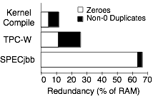
Optimizing WAN Migration
Redundancy Elimination: detect identical regions in memory or disk and only send once
Cache
Cache
VM Memory
Source
Destination
VM Memory
Notes:
mention applies to disk as well
Find numbers of disk redundancy

Slide 28
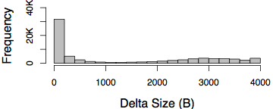
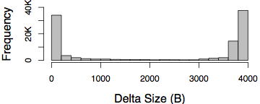
Deltas
Page Deltas: only send delta for partially changed data blocks during the migration
2
1
Cache
1
1 | 2 | 3 | 4
To send
2
Destination
Page Diff Size
Kernel compile
TPCW
web e-Commerce benchmark.

Slide 29
Smart Stop
242,987
When to stop iterating?
Xen: when very few pages left or after 30 iterations
Goals:
Minimize total migration time
Minimize pause time
Iterate until Sent < Dirtied
Reduce total time
Then, find local minimum for Dirtied
Reduce pause time
21,791

Slide 30
Implementation
Uses Xen for memory migration
Added in-memory cache for redundancy and deltas
Modified control algorithm for smart stop
Disk migration based on Distributed Replicated Block Device (DRBD)
Has sync and async modes
Evaluated benefits of redundancy elimination with traces
VPN controller manages Juniper M7i routers
Can be remotely configured
Migration wrapper coordinates network, storage, and memory operations

Slide 31


CloudNet Testbed
Testbed for exploring cloud services
3 sites spread across the US
Illinois, Texas, and California
Small cluster of servers at each site
Can create multiple VPCs with resources at each site
Migrations performed over active AT&T network links

Slide 32
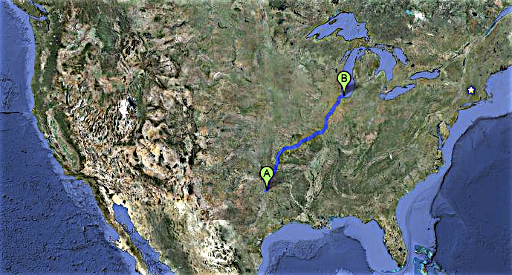
Eval: Cloud Burst
From Richardson, TX to Chicago, IL
465 Mbps link
27 msec RTT
>1200 KM distance
Simultaneous migration of four VMs
10GB disk + 1.7GB RAM per VM
Total BW consumption lowered from 37GB to 18GB
Memory migration time reduced from 245 to 87 sec
Downtime halved from 6 to 3 sec
500 mi

Slide 33
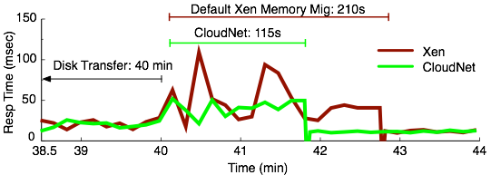
Eval: Application Performance
CloudNet reduces migration time
Shorter period with lower application performance
Synchronous disk replication reduces application performance if latency is high

Slide 34


Eval: Network Impact
Bandwidth: length of migration and pause time
Latency: network latency impact

Slide 35
Conclusions
CloudNet: end-to-end support for WAN migration
Network reconfiguration
Optimized memory and storage transfer
Minimizes migration cost
Bandwidth: Eliminate redundant data
Time: Reduce unnecessary iterations
Reduces application impact
Asynchronous bulk disk transfer
Minimize pause time
T. Wood et al., "CloudNet: Dynamic Pooling of Cloud Resources by Live WAN Migration of Virtual Machines," in IEEE/ACM Transactions on Networking, vol. 23, no. 5, pp. 1568-1583, Oct. 2015, doi: 10.1109/TNET.2014.2343945.

